Slide 1

Quadratic Functions
Modeling with quadratics, Features, Important Concepts

Slide 2
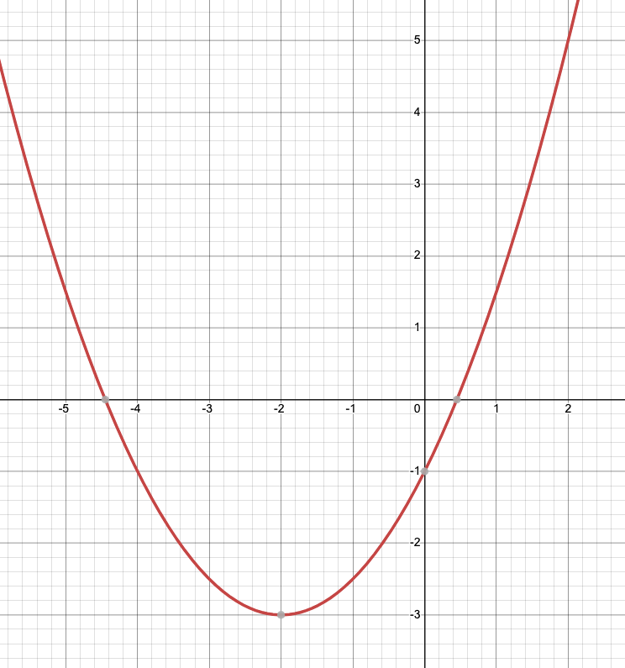

Multiple Representations
x | y
-5
-4
-3
-2
-1
0
1
2
Equation:
$f\left(x\right)=\frac{1}{2}x^{2}+2x−1$

Slide 3


Important Features of Quadratic Functions
X-intercepts can be determined by looking at the graph; they can also be calculated by solving the equation $\frac{1}{2}x^{2}+2x−1=0$
Y-intercept is just f(0)
X-intercepts
Equation in standard form:
$f\left(x\right)=\frac{1}{2}x^{2}+2x−1$
Where $a=\frac{1}{2}, b=2, and c=−1$
y-intercept
vertex

Slide 4

Important Features of Quadratic Functions
The vertex will be labeled (h, k) and can be calculated using the values of a, b, and c from the equation:
$$h=−\frac{b}{2a}, k=f(h)$$
X-intercepts
Equation in standard form:
$f\left(x\right)=\frac{1}{2}x^{2}+2x−1$
Where $a=\frac{1}{2}, b=2, and c=−1$
y-intercept
vertex

Slide 5
Important Features of Quadratic Functions
The vertex of this function is (-2,-3) which always is either the minimum or maximum of the function. Which do you think it is?
X-intercepts
Equation in standard form:
$f\left(x\right)=\frac{1}{2}x^{2}+2x−1$
Where $a=\frac{1}{2}, b=2, and c=−1$
y-intercept
vertex

Slide 6


Important Features of Quadratic Functions
The vertex (-2,-3) also allows us to rewrite the function in vertex form:
$$f\left(x\right)=a{(x−h)}^{2}+k$$
Plugging in our numbers we get:
$$f\left(x\right)=\frac{1}{2}{(x−(−2))}^{2}+\left(−3\right)$$
$$f\left(x\right)=\frac{1}{2}{(x+2)}^{2}−3$$
X-intercepts
y-intercept
Equation in standard form:
$f\left(x\right)=\frac{1}{2}x^{2}+2x−1$
Where $a=\frac{1}{2}, b=2, and c=−1$
vertex

Slide 7
Why quadratic functions matter
When we multiply two linear functions, we get a quadratic function.
Example: Revenue = Unit cost * Quantity and Unit Cost is not constant but linear
Example: Revenue = Demand * Quantity and Demand is linear

Slide 8
Application #1: Maximize Revenue in a Subscription
Let
Let x = the unit charge per subscription, S = the number of subscribers, and revenue R(x) = S * x
Assume
Assume S = -2500x + 159,000 (which means it acts like a demand function)
Show
Show that the maximum revenue will occur when x = $31.80 and revenue amount will be $2,528,100

Slide 9
Application #2: Maximize profit in sales of a new wearable fitness device
Let x = the quantity of devices sold, p(x) = the price as a function of x, and revenue R(x) = p(x) * x. Cost must also be given.
Profit = Revenue - Cost
Assume p(x) = -0.002x + 160 and C(x) = 700,000 + 30x
What does 30 represent? What is the meaning behind -0.002?
Write an equation for Profit. Is it a quadratic?

Slide 10

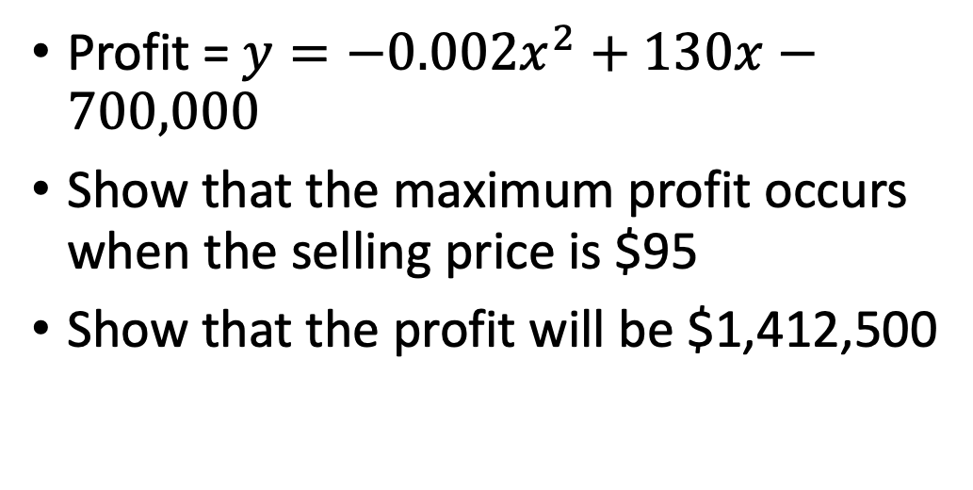
Application #2: Maximize profit in sales of a new wearable fitness device
Profit = $y=−0.002x^{2}+130x−700,000$
Show that the maximum profit occurs when the selling price is $95
Show that the profit will be $1,412,500

Slide 11
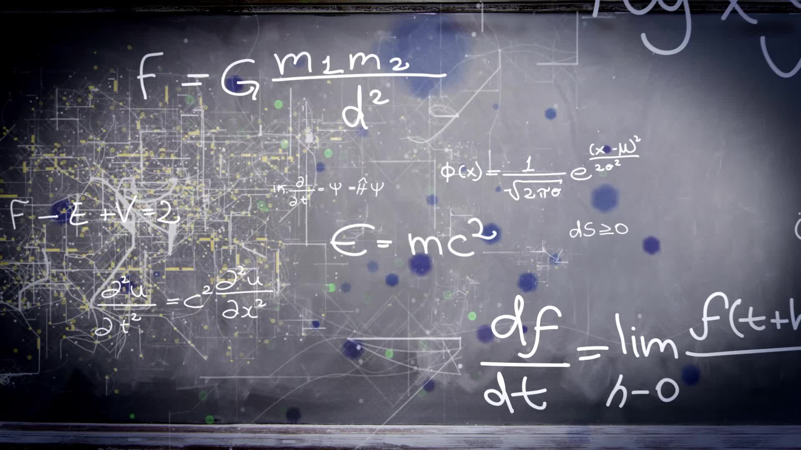
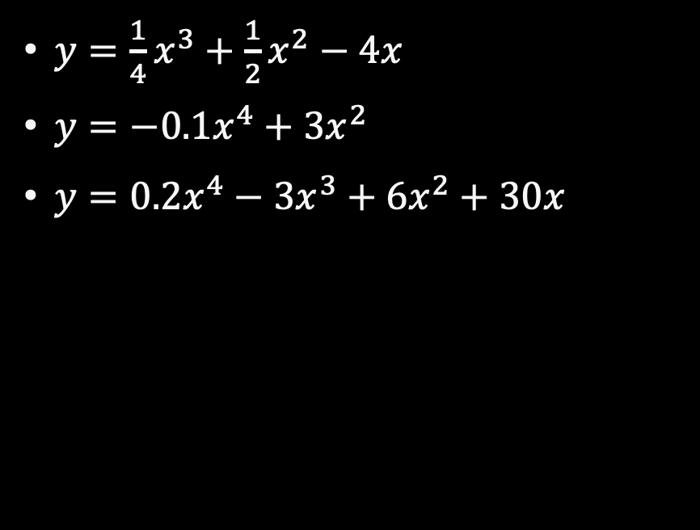
General Polynomials
$y=\frac{1}{4}x^{3}+\frac{1}{2}x^{2}−4x$
$y=−0.1x^{4}+3x^{2}$
$y=0.2x^{4}−3x^{3}+6x^{2}+30x$
Using a graphing tool of your choice, can you identify primary features of these three polynomials? Note: There will be more than one vertex for each of these

Slide 12
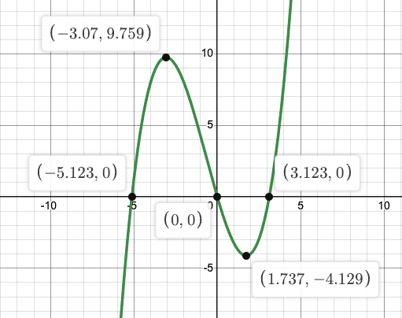
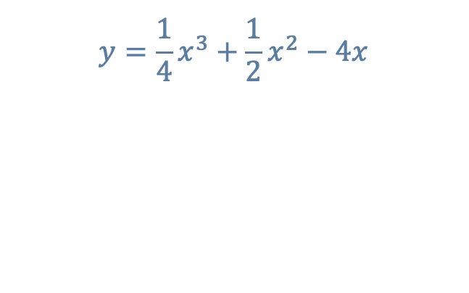
$$y=\frac{1}{4}x^{3}+\frac{1}{2}x^{2}−4x$$
We have two vertices (a maximum and minimum point)
We have 3 x-intercepts
One of the x-intercepts is also the y-intercept

Slide 13
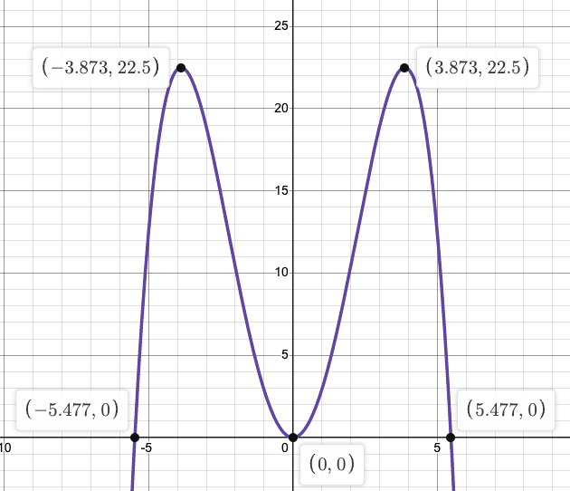
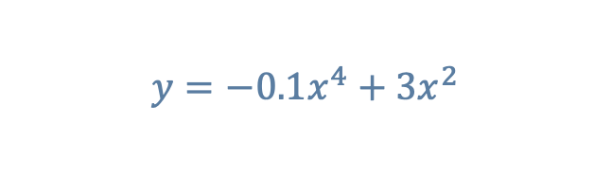
$$y=−0.1x^{4}+3x^{2}$$
We have three vertices (two maximum and one minimum point)
We have 3 x-intercepts
One of the x-intercepts is also the y-intercept as well as being a minimum (0,0). This polynomial also has symmetry.

Slide 14
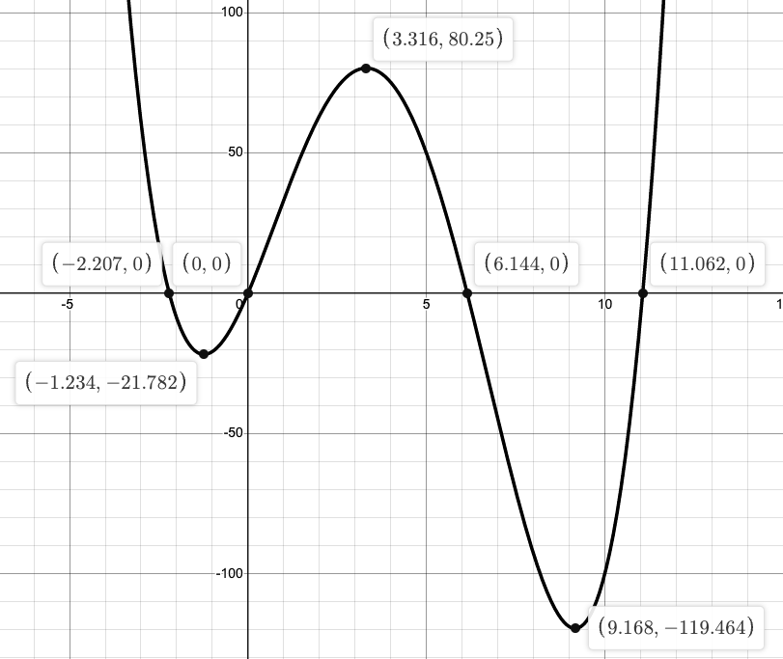
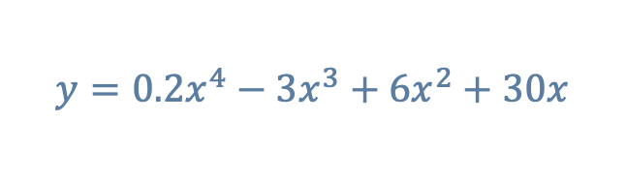
$$y=0.2x^{4}−3x^{3}+6x^{2}+30x$$
We have three vertices (one maximum and two minimum points)
We have 4 x-intercepts
One of the x-intercepts is also the y-intercept.

Slide 15
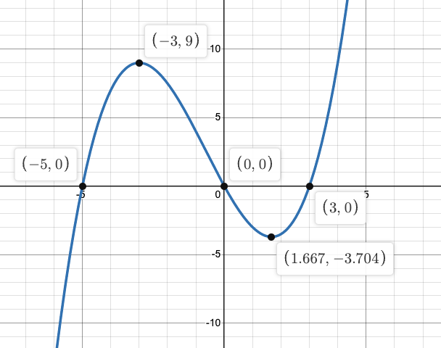
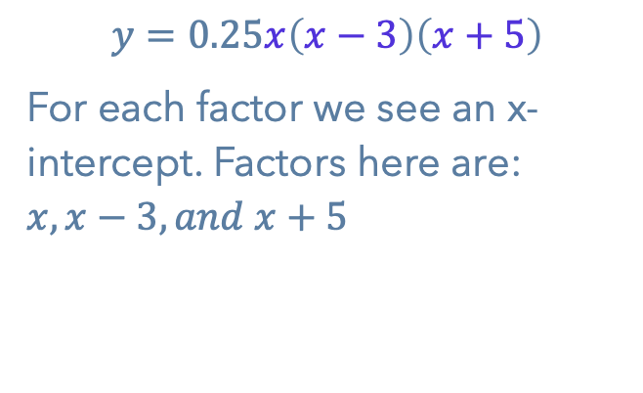
A polynomial in factored form
$$y=0.25x\left(x−3\right)\left(x+5\right)$$
For each factor we see an x-intercept. Factors here are: $x, x−3, and x+5$

